Slide 1
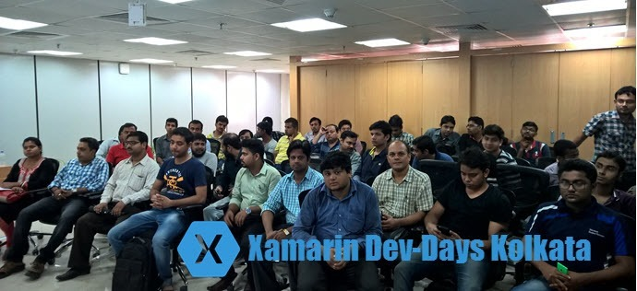

Slide 2



Cloud First, Mobile First
Kunal Chowdhury
Microsoft MVP (Windows Platform Development)
Windows 10 Champion | www.kunal-chowdhury.com
@kunal2383

Slide 3

why is mobile so important?

Slide 4

The average app user has approximately 36 apps installed on his or her phone

Slide 5
Only 1/4th of the apps we use daily

Slide 6
1/4th of apps we never use

Slide 7

Bad App Experiences
Slow or leggy experience
Crashes
Not intuitive & bad user experience
Features not as advertised
Data not available when you need it

Slide 8


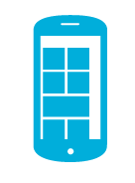
Challenges
Internal/External apps from single Portal:
Enterprises want to manage internal mobile apps and consumer facing event or product-specific mobile apps from the same portal as core LOB apps.
Development Time & Costs:
Small Businesses require solutions that accelerate development time and decrease development costs.

Slide 9
Challenges
Utilization of Common Backend Service:
Developers shouldn’t have to constantly reinvent the wheel and reproduce common backend functionality.
Multi-platforms:
Consumers expect a continuous experience across all devices.

Slide 10

Are you connected?

Slide 11

What about backend?

Slide 12

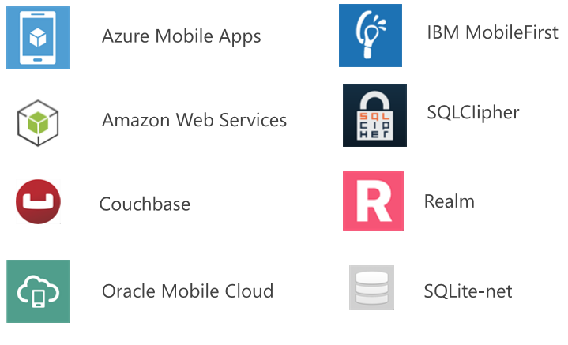
Plenty of options...

Slide 13
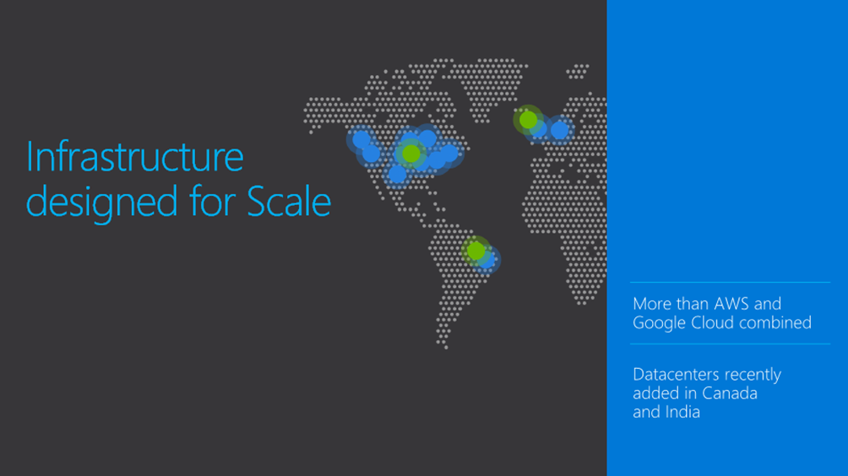

Slide 14

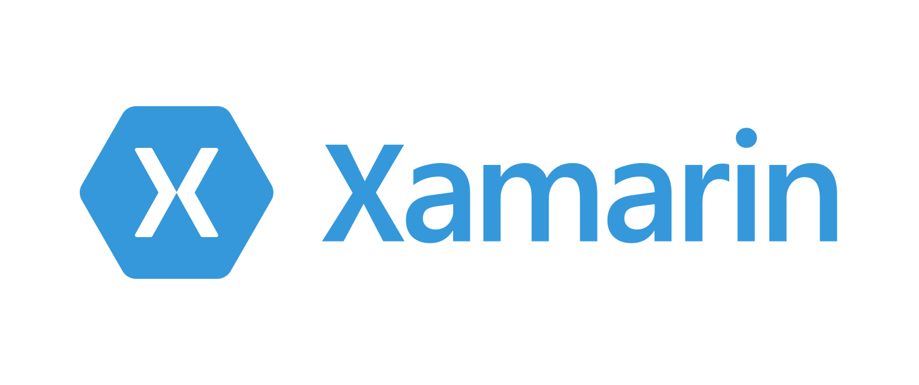
Why Azure?
Extremely Powerful
Flexible (Easy Tables, App Service)
C# SDKs available (iOS, Android & Windows)

Slide 15
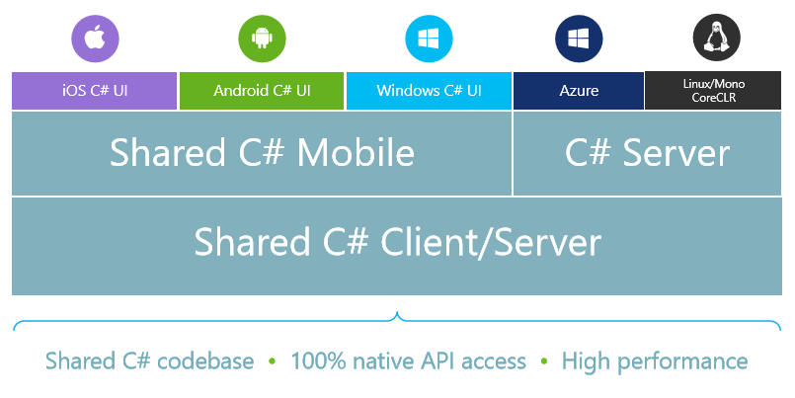
Xamarin Apps + Backend Services

Slide 16
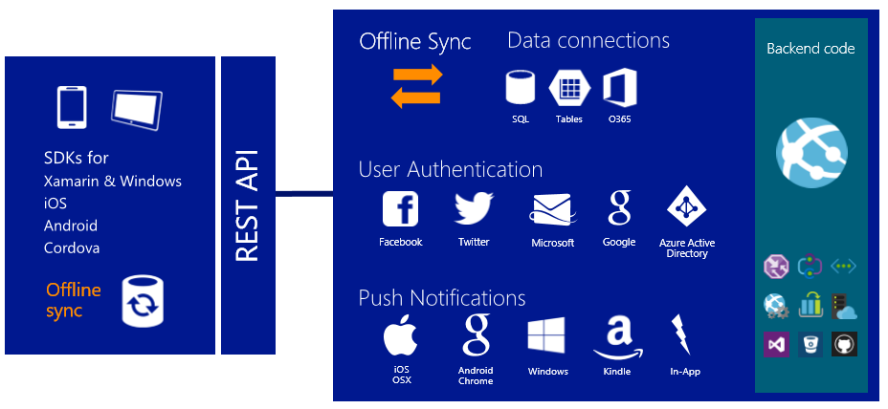
Azure Mobile Apps

Slide 17
Key Scenarios
Make your app engaging and dynamic
Push notifications and Live Tiles is the premier way to engage your customers. Make your app engaging and dynamic using Mobile Services Push.
Rapid Development
Time is money. Get your app up and running sooner when you use Mobile Services to configure a secure backend in less than five minutes.
Make your app social
Whether your customers use Google, Facebook, Twitter or Microsoft Account, no matter what devices they run your app on, with Mobile Services you can make your app social and personable fast.

Slide 18
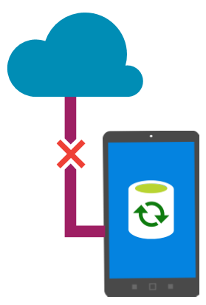
Mobile Offline Sync
Make apps resilient against intermittent network connectivity
Allow end-users to create and modify data even when there is no network access
Sync data across multiple devices

Slide 19
Mobile Offline Sync
Improve app responsiveness by caching server data locally on the device
Detect and handle conflicts when the same record is modified by more than one client

Slide 20
How Offline Sync works?
Access data from Mobile Apps tables even when the app is offline
Keep a local queue of Create, Update, Delete operations and synchronize with server when the app is back online

Slide 21
How Offline Sync works?
Detect conflicts when same item is changed both locally and on server
Use soft delete to remove deleted records from client data store
Can use push notifications to trigger client sync

Slide 22

Authentication
Rolling your own account infrastructure is difficult and time consuming
Secure your app with prebuilt authentication
    Twitter
    Facebook
    Google
    Microsoft

Slide 23
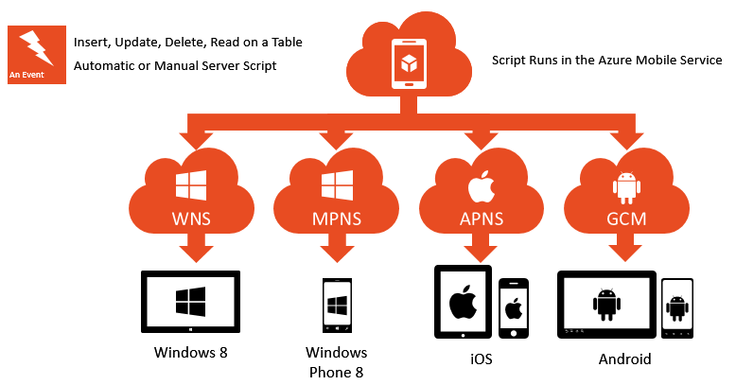
Push Notifications

Slide 24
Azure Mobile Client SDK
C:\Windows\System32\cmd.exe
Microsoft Windows [Version 7.1.7000]
Copyright (c) 2008 Microsoft Corporation. All rights reserved.
PM> Install-Package Microsoft.Azure.Mobile.Client

Slide 25
MobileServiceClient client = new MobileServiceClient("MOBILE_APP_URL");
How to create a Mobile Service Client?
MobileServiceClient client = new MobileServiceClient(“http://devdayskol16.azurewebsites.net");

Slide 26
MobileServiceClient client = new MobileServiceClient("MOBILE_APP_URL");
The Data Model
public class TodoItem
{
public string Id { get; set; }
[JsonProperty(PropertyName = "text")]
public string Text { get; set; }
[JsonProperty(PropertyName = "complete")]
public bool Complete { get; set; }
}

Slide 27
MobileServiceClient client = new MobileServiceClient("MOBILE_APP_URL");
How to do CRUD operations?
// insert a record
await todoTable.InsertAsync(todoItem);
// update a record
await todoTable.UpdateAsync(todoItem);
// delete a record
await todoTable.DeleteAsync(todoItem);
// query a record
List<TodoItem> items = await todoTable.ToListAsync();

Slide 28

Connect with me:
www.kunal-chowdhury.com
twitter.com/kunal2383
facebook.com/blog.kunal
Slides: http://po.st/xamarindevdays

